Slide 1
In/With/When

Slide 2
In The

Slide 3
The

Slide 4
And

Slide 5
From

Slide 6
To/For

Slide 7
To The/For The

Slide 8
Like/As

Slide 9
That

Slide 10
When

Slide 11
You/Your

Slide 12
You/Your

Slide 13
You/Your

Slide 14
You/Your

Slide 15
Them/ Their

Slide 16
Him/His/It

Slide 17
Her/It

Slide 18
Her/It

Slide 19
My

Slide 20
My...s (plural)

Slide 21
Our

Slide 22
...S (plural)

Slide 23
...S (plural)

Slide 24
...S (of)

Slide 25
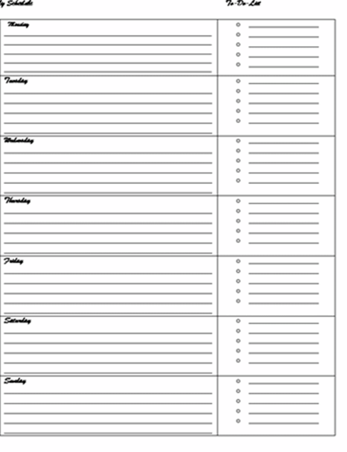
I Will

Slide 26
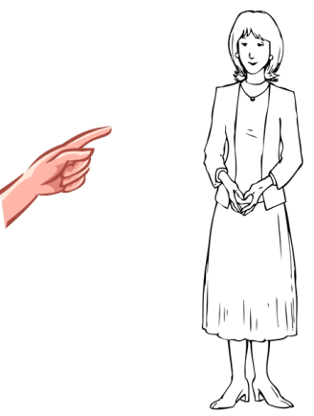
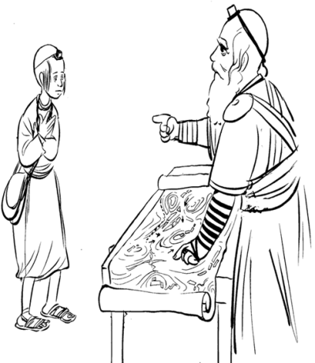
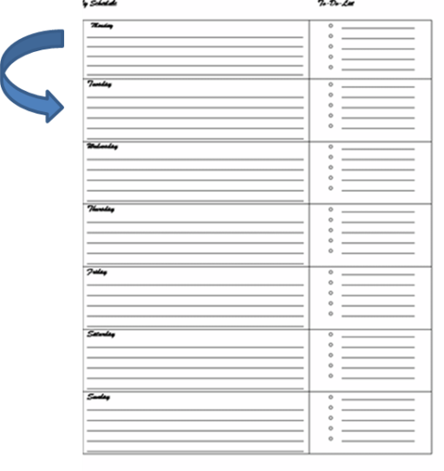
You will (male)
She will

Slide 27
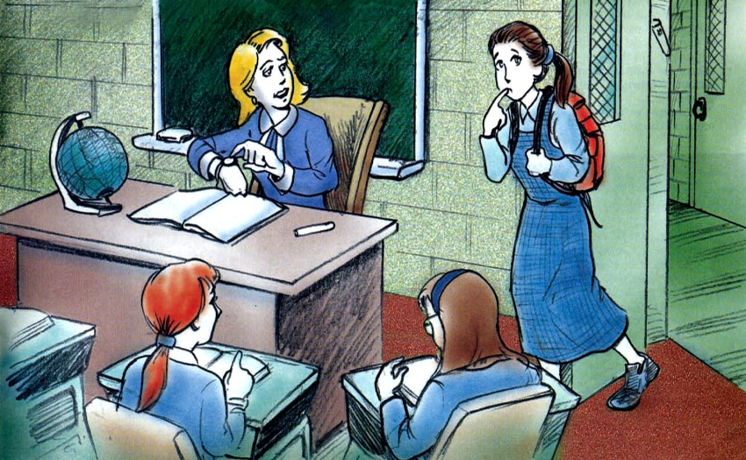
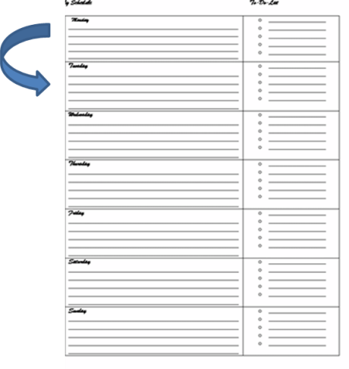
You Will (female)

Slide 28
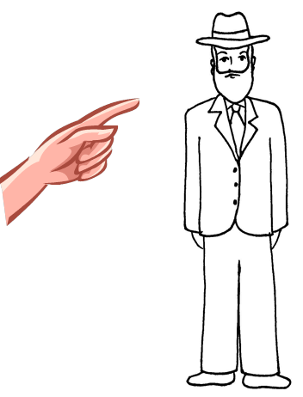
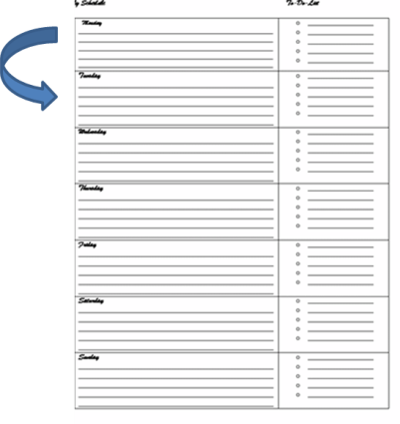
He Will

Slide 29
We Will

Slide 30
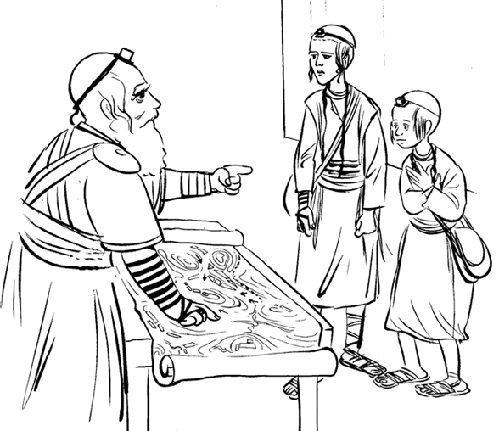
You Will (plural)

Slide 31
They Will

Slide 32
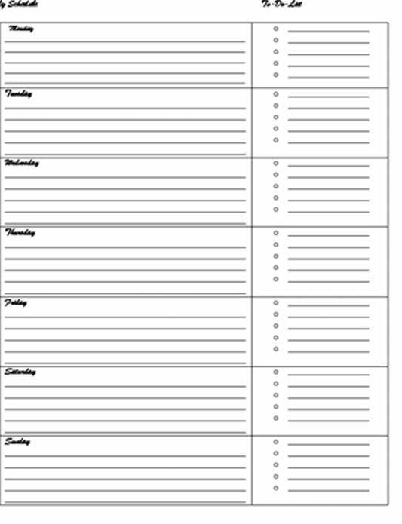
I (past)

Slide 33
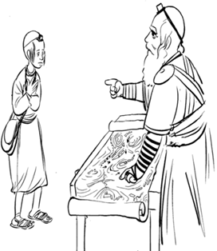
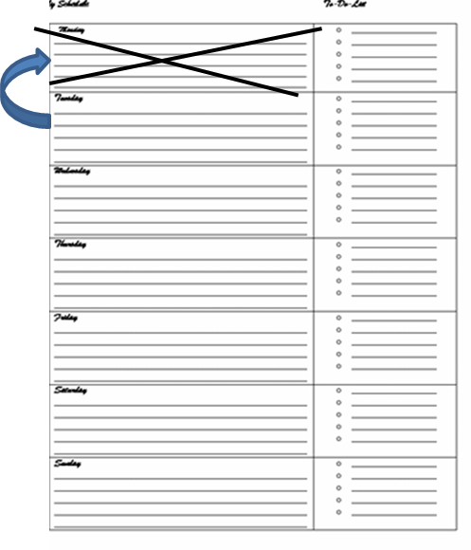
You (past, male)

Slide 34
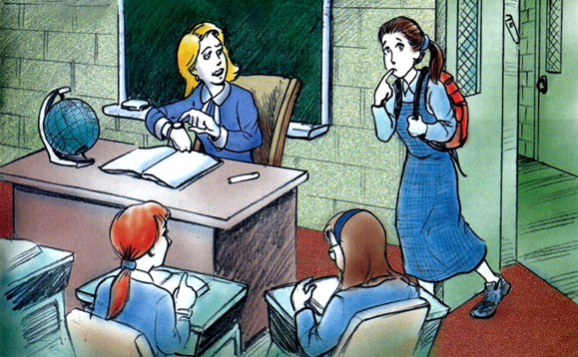
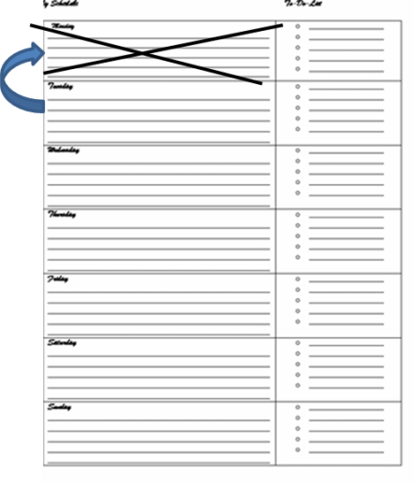
You (past, female)

Slide 35
You (past, plural)

Slide 36
He (past)

Slide 37
She (past)

Slide 38
We (past)

Slide 39
They (past)

